Slide 1

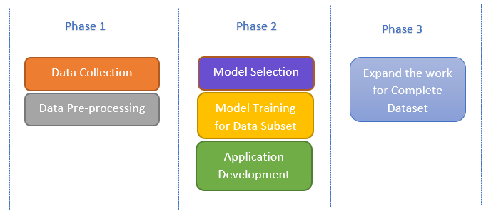
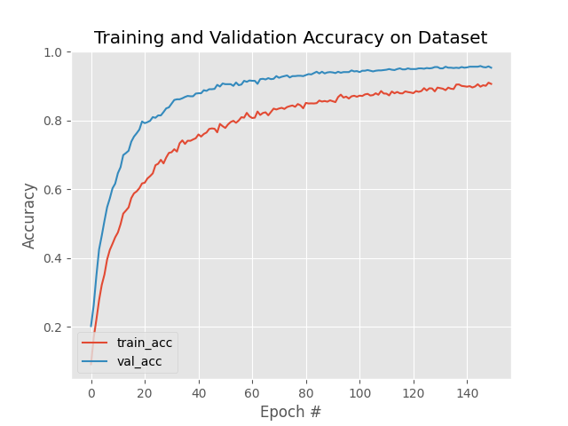
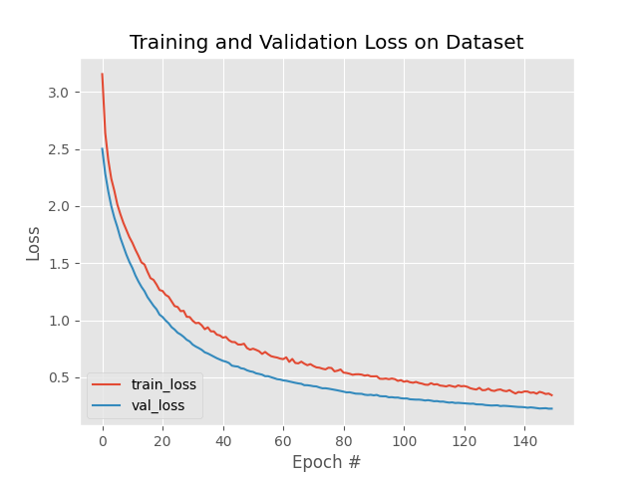
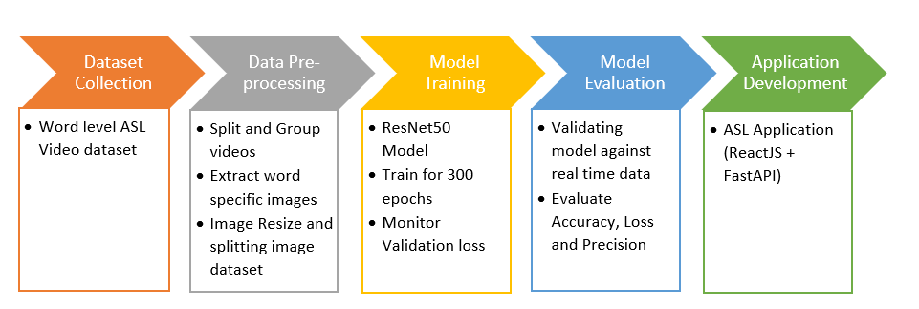
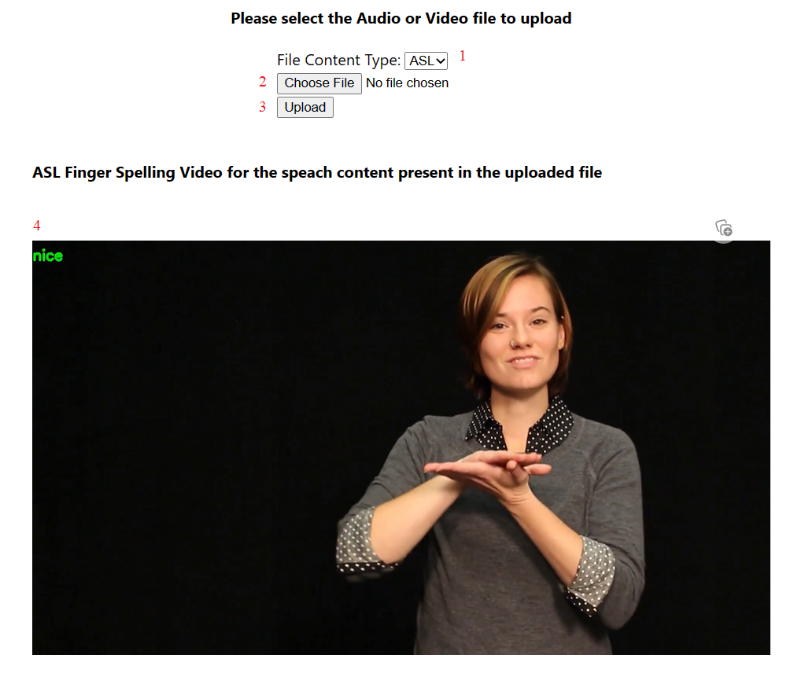
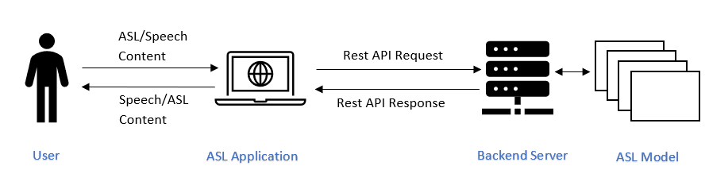
ASL to English and English to ASL Vijayendra Dushyanth Raj Avina, Md Amiruzzaman (Ph.Ds.), Stefanie Amiruzzaman (Ph.D.) Department of Computer Science, and Department of Languages and Cultures
Abstract
Communication is an essential part of human life without which life would be difficult. Also, it is not possible if both parties do not know the syntax and semantics of the language used. Deaf and Hard-of-hearing people in America majorly use American Sign Language (ASL). ASL is not understood by many people who use speech to communicate because of a lack of knowledge of the signs used. Due to this the communication between these people is very minimal or takes a lot of time to understand. To facilitate communication between hearing people and Deaf people, there is some research done in the computer science department. Many studies concentrated on basic signs like signs representing English alphabets and numbers. In this study, we are tried to recognize word-level signs of ASL using Deep Learning (DL) models namely Convolutional Neural Network (CNN) model. We trained the CNN model using the open-a public ASL dataset. The rolling averaging is used to predict the English words correspond to ASL signs. We also developed an application that acts as a translator between hearing and Deaf people by translating ASL into English and English into ASL.
To this Resnet50 model, we added an AveragePooling2D layer with pool size of (7,7), flatten layer, two Dense layer out of which one acts as output layer and a Dropout layer in between Dense layers.
The model is then compiled and trained with data subset consisting of images corresponding to 15 words. We set the learning rate of the model to 0.0001. The SGD optimizer is used to make the learning quicker. We trained the model for 150 epochs; each epoch consists of 97 steps.
Model Evaluation
The model trained is evaluated using few sample test images to check how well it predicts the word. Please see Evaluation results section to know more.
Application Development
We developed an application where the user can upload an audio or ASL file, based on the file type, we translate the content to ASL or English text.
Evaluation Results
While training the model, the accuracy of the model increases quickly in the beginning and after some epochs it makes steady progress.
We were able to achieve 95.31% validation accuracy and 90.61% testing accuracy.
The whole research is divided into 3 phases. In phase 1, we collected the dataset and performed pre-processing on the dataset. In phase 2, the current phase, we choose the CNN model as Resnet50 and trained the model with subset consisting of 15 words and developed the ASL translation application dashboard. In phase 3, we will expand our work to complete dataset.
Methodology
To identify the ASL using Resnet50 model, we should train the model with sample dataset. The detailed steps involved in the complete process is given below.
Introduction
ASL is a visual gesture language used by around 500,000 members of North American Deaf Community. It has vast variety of signs which makes it difficult to understandable by hearing people without proper knowledge. This lack of knowledge is forming a barrier in the communication between hearing and Deaf people.
To ease the communication barrier between Deaf and hearing people, we propose a solution using DL. We train the Resnet50 CNN model to recognize the different signs of ASL and translate it to corresponding English word.
Dataset Collection
We obtained the public accessible word level dataset from Kaggle. The dataset consists of ASL videos for 2000 English words.
Data Pre-processing
The image containing unique gesture corresponding to the word are extracted from the ASL video. The images are resized to 224x224 pixels for uniformity and converted from RGB to BGR format for better training purpose. The images are split into two folders, train and test in the ratio of 75%/25%.
Model Training
We used the concept of transfer learning to build and train our model. Transfer learning is nothing but making use of the information available in a model constructed for a different task. We used the Resnet50 model with ImageNet weight as the base model for our ASL recognition.
The above graph represents the training and validation loss occurred while training the model.
The loss decreases quickly in the beginning, and it becomes steady after some epochs.
Future Scope
As mentioned, we will expand our work to whole dataset in phase 3.
Currently we are producing video consisting of ASL fingerspelling for the speech file uploaded by the user. In future we want to produce the video with corresponding word level ASL.
We want to provide a way to the user to contribute to our dataset so that we can expand our dataset and train our model to support as many signs as possible.
Once the model is trained and evaluated, it was hosted in server using pythons’ FastAPI framework. An application dashboard was created using ReactJS framework. The dashboard developed allows user to decide the kind of translation needed (Annotated 1). User has to upload the origin file to translate (Annotated 2 & 3). Once user uploads the file, the request is sent to backend model to perform the appropriate translation. Once the translation is done, the backend server sends the translated video to the dashboard which is played to user (Annotated 4).
References
ASL-American sign language. https://www.lifeprint.com/asl101/pages-layout/lesson1.htm.

